Slide 1
Payroll Management System
By Nicolás Guevara Herrán

Slide 2

Agenda
Introduction
ER Diagram
Web Services

Slide 3

Introduction
This Project is developed as part of the Database Foundations course and aims to provide a robust and efficient solution for managing payroll operations. The system integrates PostgreSQL for database management and FastAPI for web services, ensuring seamless handling of employee data, payroll calculations, allowances, deductions, and user activity logging.

Slide 4
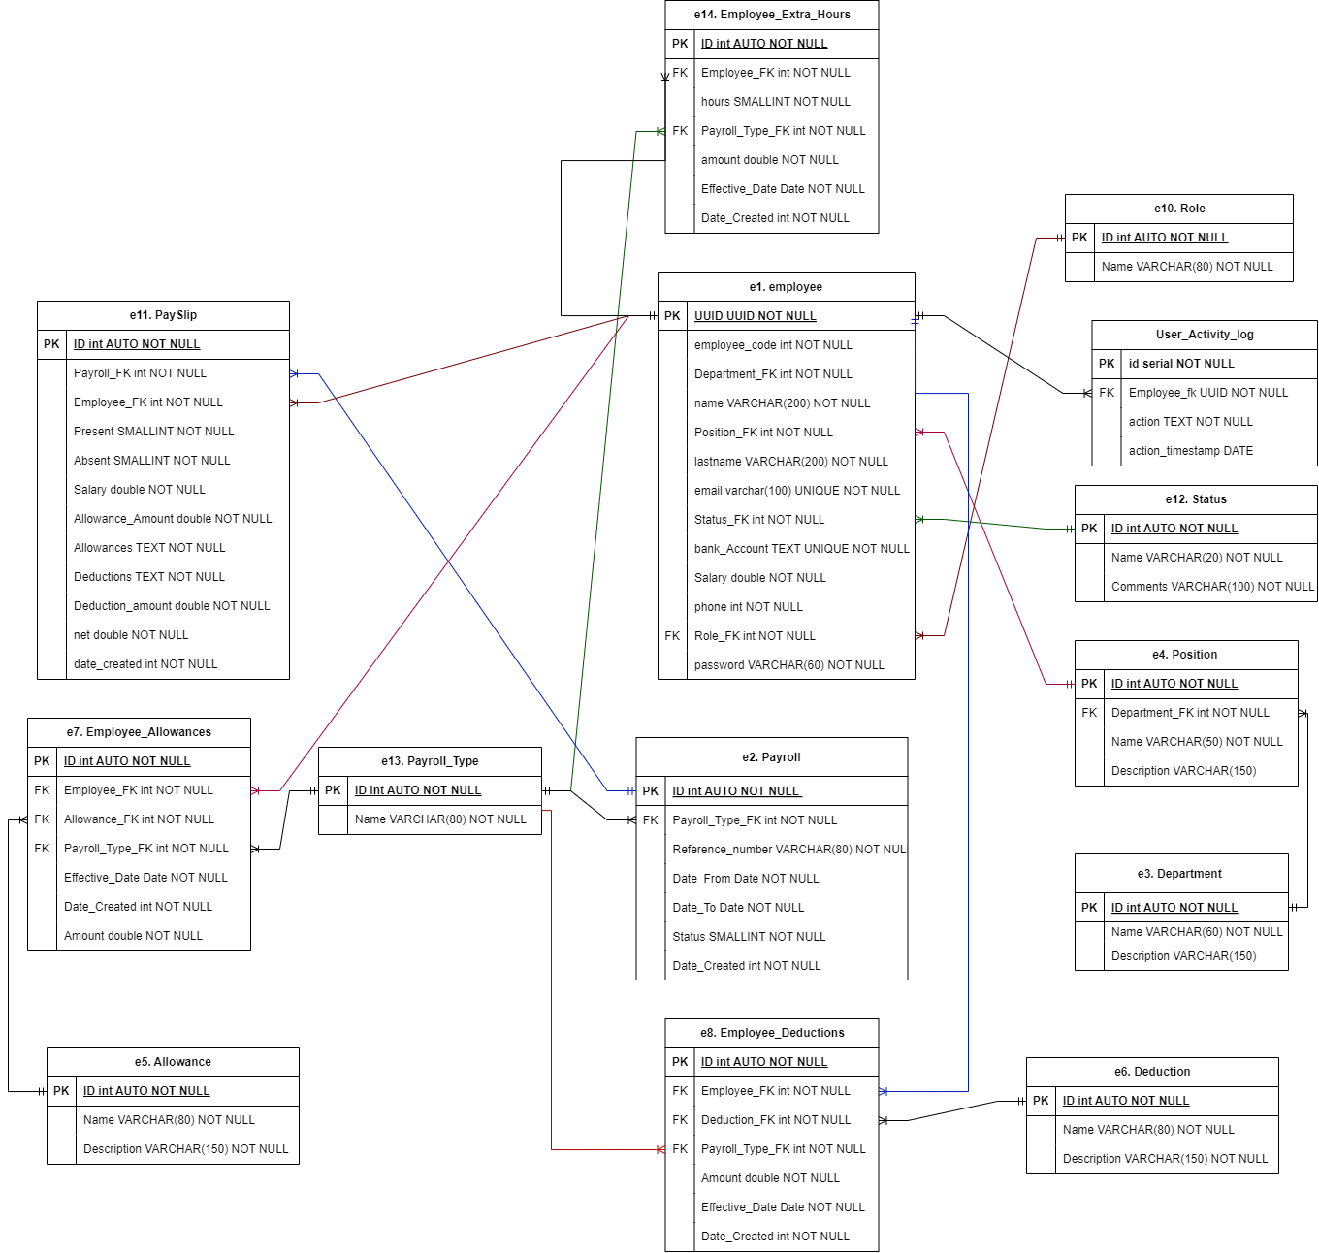
Entity Relationship Model

Slide 5
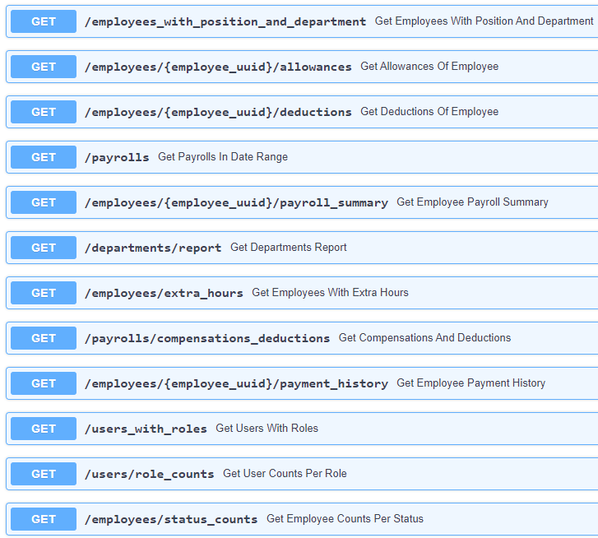
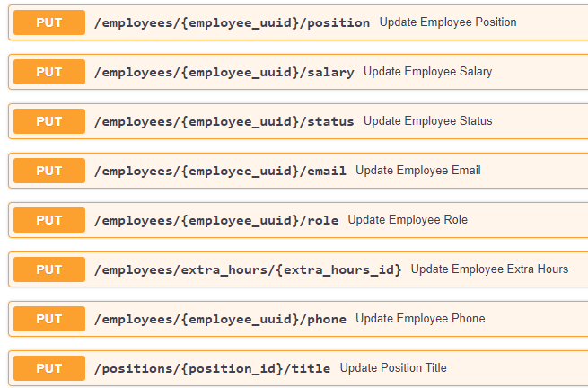
Web Services

Slide 6
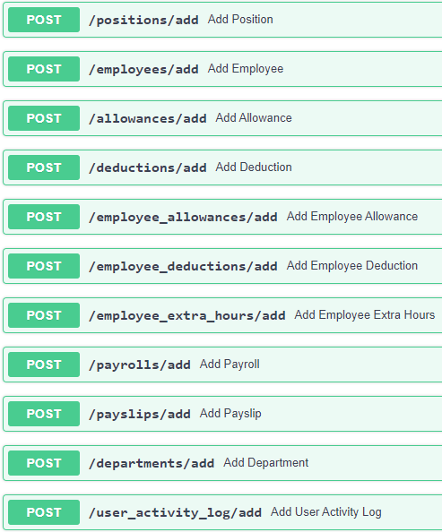
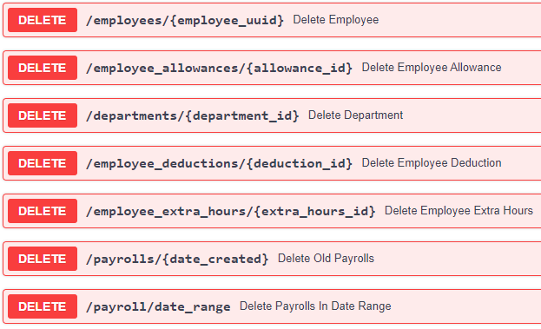
Web Services

Slide 7
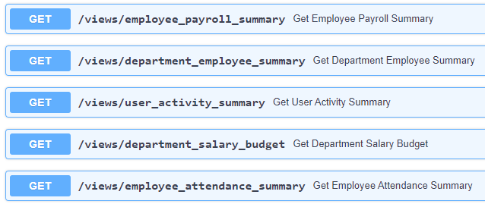
Web Services

Slide 8
Gracias
Nicolás Guevara Herrán
nguevarah@udistrital.edu.co

